Slide 1
Partnering
With Your
PACs
What School Committee Members Can Do To Support SEPACs and ELPACs/MLPACs
Charting the Course
Notes:
Here’s what we’ll cover.
Unscripted Introductory Remarks followed by:
Welcome to this presentation on Special Education. I am going to ask Jim Hardy to explain the protocols for you to participate.
(After Jim speaks [continue script]
You do not need to be a specialist, teacher, clinician or expert to fulfill your role. Leave that to the faculty and administration.
You do need to have a basic understanding of several items.
[CHANGE SLIDE]

Slide 2
What We’ll Cover:
School Committee Responsibilities
What is a SEPAC?
What is an ELPAC?
Questions of Equity
Supporting Your PACs
Resources
Beyond the PACs
Questions/Comments
Notes:
Key Legislation and Regulations [next]
What policies you need to have. [next]
What are the Roles and Responsibilities for School Committees [next]
Dealing with parents.
Jim is going to lead you on a very brief poll to see what, if any, special education experience you have.
[CHANGE SLIDE]

Slide 3
School Committee Roles:
Establish district policies
Establish budget
Confirm superintendent’s recommendation for special education director
Advocate for Students with Special Needs and English/Multilingual Learners
Notes:
Approving the Special Education Budget. [next]
Special Education is going to be part of your strategic plan and district goals. These are matters of policy. [next]
Confirm the Superintendent's recommendation for the Director of Special Education. In certain circumstances, a SPED Director may serve more than one district — such as in a superintendency union. [next]
It is not a legal requirement, but many school committee members see themselves as advocates for students who are clients of SPED.
[CHANGE SLIDE]

Slide 4
What is a SEPAC?
"The school committee of any city, town, or school district shall establish a parent advisory council on special education. Membership shall be offered to all parents of children with disabilities and other interested parties.
The parent advisory council duties shall include but not be limited to: advising the school committee on matters that pertain to the education and safety of students with disabilities; meeting regularly with school officials to participate in the planning, development, and evaluation of the school committee's special education programs.
The parent advisory council shall establish by-laws regarding officers and operational procedures. In the course of its duties under this section, the parent advisory council shall receive assistance from the school committee without charge, upon reasonable notice, and subject to the availability of staff and resources. …"
MGL Chapter 71B, Section 3

Slide 5
What is an ELPAC?
The "Act Relative to Language Opportunity for Our Kids," Chapter 138 of the Acts of 2017, commonly referred to as the “LOOK Act,” was signed into law by Governor Baker on November 22, 2017.
Related to ELPACs, the LOOK Act requires the following schools or districts to establish ELPACs:
School districts or charter schools operating a language acquisition program for ELs serving 100 or more ELs
School districts in which ELs comprise at least five percent of the school district’s or charter school’s student population, whichever is less.
Schools designated as underperforming or chronically underperforming and operating a program for ELs.

Slide 6
Questions Of Equity:
Challenges to delivering equitable services:
Family resources are not inherently equitable
System favors available and active parents
Professional advocacy is expensive
Avoiding “classification” stigma
Minority students more likely to be labeled
Language barriers can impede access
Teacher advice not always accepted
Notes:
Providing Equitable Services can be a challenge because:
The system favors strong parent advocates or those who have access to professional advocacy resources. [next]]
Students with strong advocates and/or knowledgeable parents are more likely to get help, that falls on the executive functioning spectrum: additional time to take tests: MCAS, SAT, and AP. Parent advocates know how to get special accommodations and supports. Often the parent will ask for a one-to-one aide, or just more services. [next]
Some students who need special help or might not be classified as "disabled" might end up excluded from special education services. [next]
An important goal of special education services is to avoid the "classification" of students. When SPED classes were first placed in schools, most students with special needs were placed in classes and were "classified" as "inclusion" students [next].
Many parents of color consider "special education" a stigma that they do not want associated with their child. Economically disadvantaged students and kids of color may be at risk of classification rather than being offered appropriate interventions, which may assist the student's ability to learn, due to unrecognized bias. [next]
It has been recommended that teachers would be best to determine who needs extra services [NEXT SLIDE]

Slide 7
Supporting Your PACs:
Support PACs in holding meetings in person or virtually.
Send a SC liaison to the PAC meetings.
Invite a PAC representative to sit with you as an exofficio participant in your meetings.
Invite the PACs to a School Committee meeting to present on their activities.
Evaluate and create district policies that consider all students and families by soliciting input from PACs.
Support the sharing of district information regarding PACs with the entire community.
When putting together advisory committees, share out to the PACs to ensure stakeholder involvement.

Slide 8
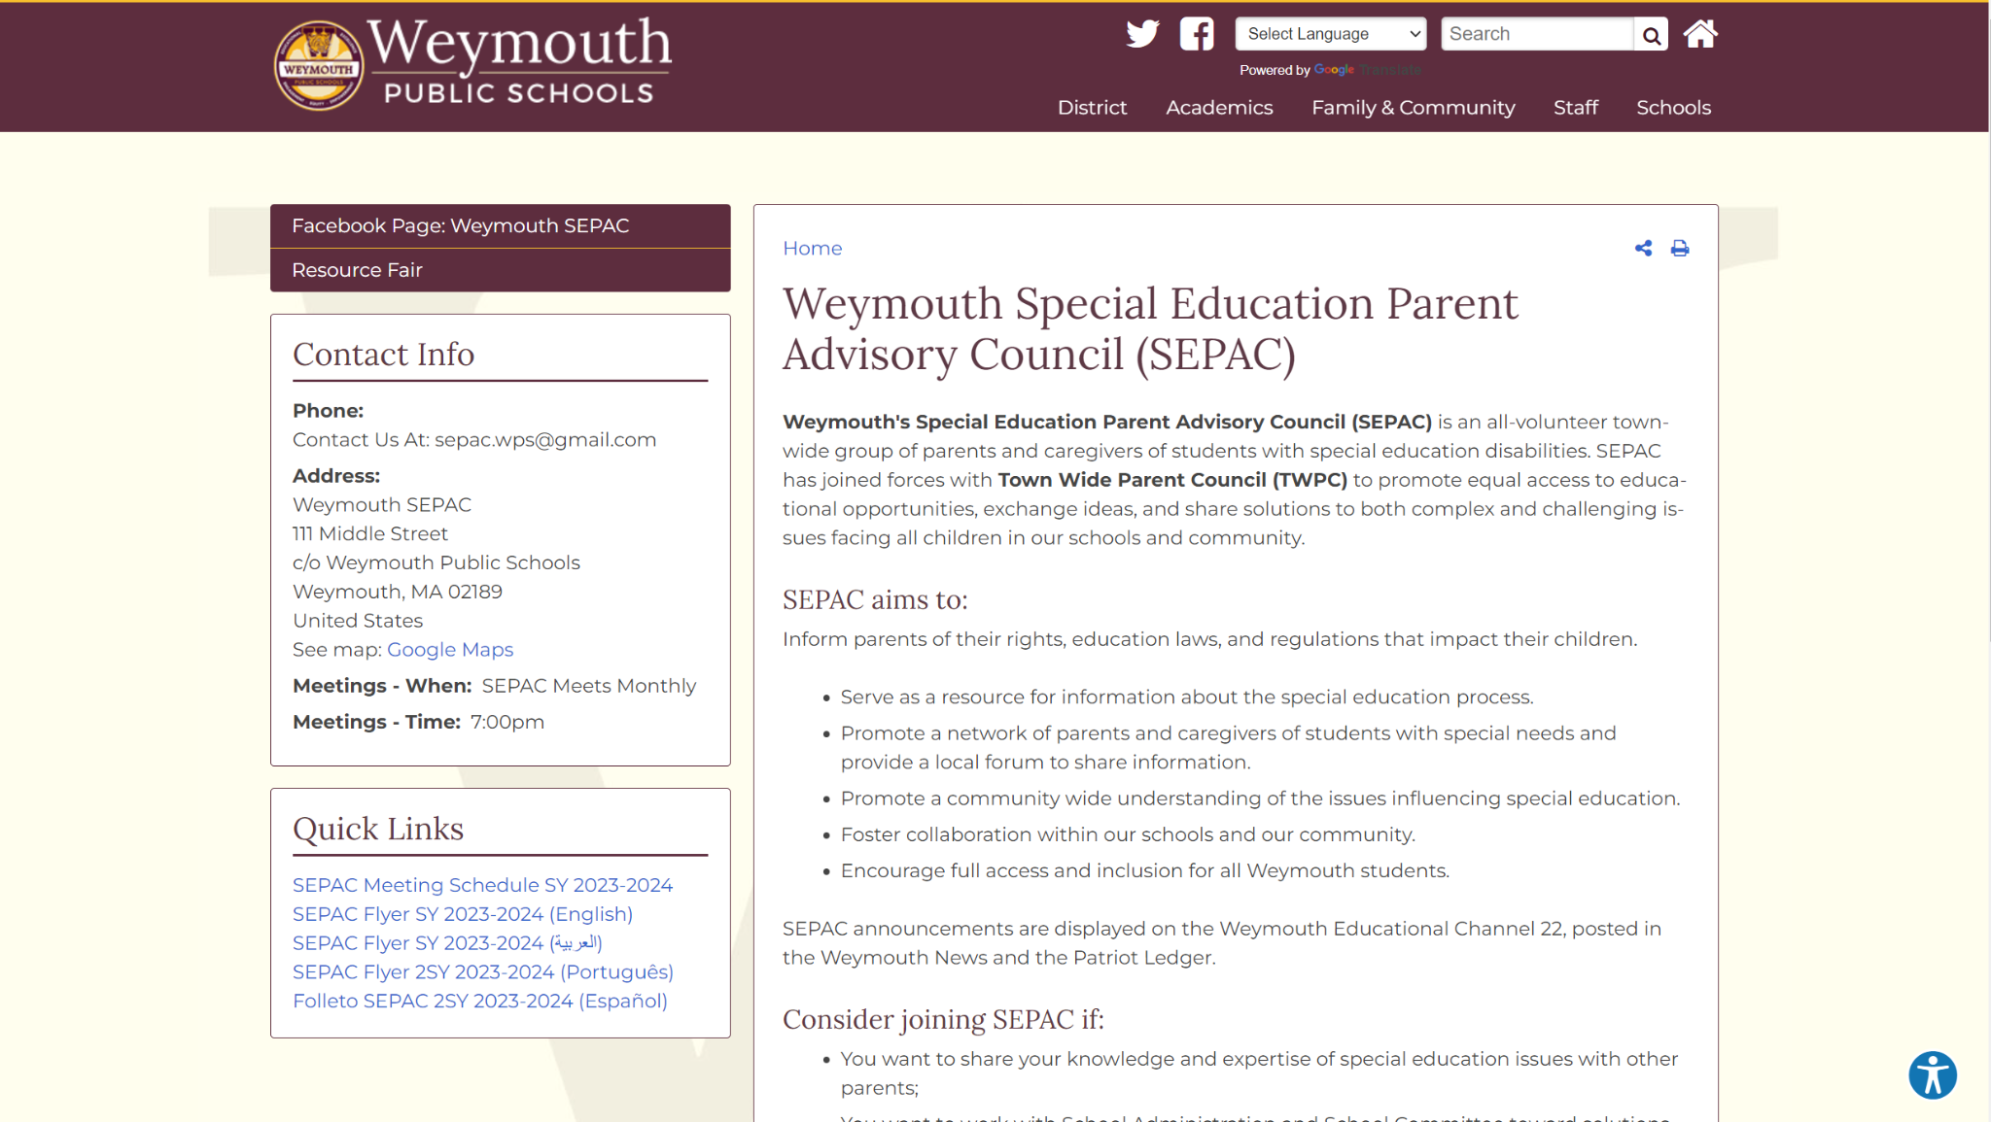

Slide 11
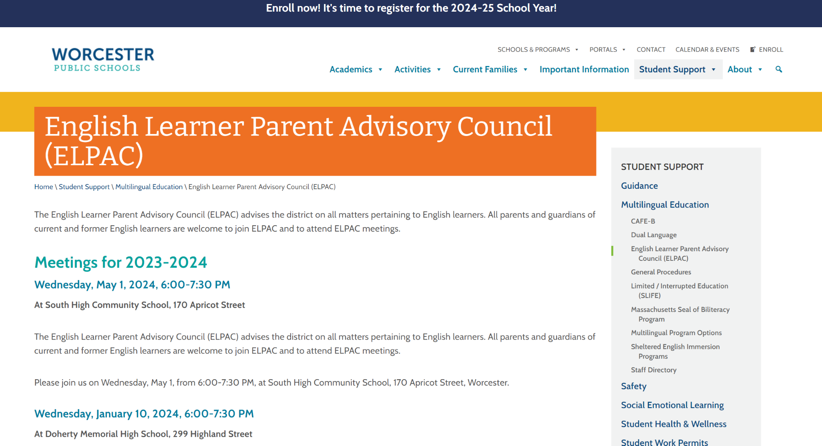

Slide 12
Resources:
MA DESE Guidance for SEPACs and ELPACs https://www.doe.mass.edu/
The Federation for Children with Special Needs https://fcsn.org/ MASSPAC https://fcsn.org/masspac/ The Federation’s ELPAC Guidance https://fcsn.org/wp-content/uploads/sites/2/2022/05/English-Learners-and-ELPACs.pdf

Slide 13
Beyond the PACs:
Advocating for higher state funding for Special Education and Multilingual Learners.
Advocating for Relevant Bills in MA House and Senate.
Full funding for federal mandates.
Notes:
Full finding of the circuit breaker that we just discussed.
Getting more funds for special education in general.
Urging Congress to fulfill the promise for more SPEd funding.
Visiting the schools where their students attend to assess quality of services.
Prioritizing privacy rights.
And joining the Parent Advisory Council.
The PAC is a state mandated parent group that is supposed to meet with the school committee and superintendent and advocate for the best interests of students and families. Depending on the community where you live, you may have served on a PAC (a lot of school committee members have), or you might attend the PA

Slide 15
Upcoming MASC Events:
May 4 in Hanover - Charting the Course
May 6 in Boston - Day on the Hill
May 8 Virtual - Division IX Resolutions Clinic
May 18 in Gardner - Charting the Course
June 8 in Harwich - Charting the Course
June 22 in Burlington - Charting the Course
Looking Ahead:
Summer Institute July 12-13
Joint Conference in November
Notes:
Approving the Special Education Budget. [next]
Special Education is going to be part of your strategic plan and district goals. These are matters of policy. [next]
Confirm the Superintendent's recommendation for the Director of Special Education. In certain circumstances, a SPED Director may serve more than one district — such as in a superintendency union. [next]
It is not a legal requirement, but many school committee members see themselves as advocates for students who are clients of SPED.
[CHANGE SLIDE]

