Slide 1
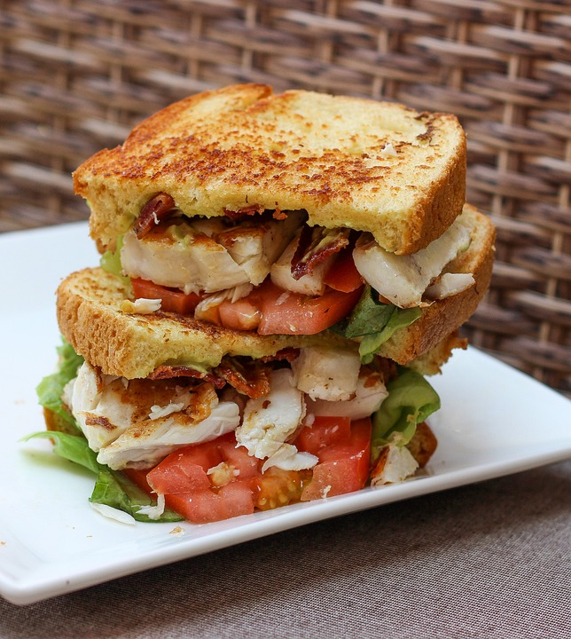
Leadership for Lunch
April 24, 2024

Slide 3
Agenda
Introductions
Purpose of Sessions
Building a community of learners
Networking
Refining your Leadership Skills
Practicing mindfulness techniques
Today’s Goal:
Building background and getting to know one another

Slide 4
GROUP NORMS
Start & end
on time
Accept, respect,
& learn from
our differences
Assume
Positive Intent
Be Fully Present
Allow for
equity of voices
during discussions
Notes:
attention- means screens on please. active participation- Our meeting will only as good as we all give to it.

Slide 5
Looking Inward
Take a moment to reflect on the aspects of your work that bring you the most joy and the various ways your skill set provides value.

Slide 6
Administrative assistants are often the unsung heroes of the workplace. They serve as the backbone of office success. Why? Because they provide essential administrative duties that ensure the smooth operation of a business. From managing calendars to coordinating meetings and much more, administrative assistants take on a range of important responsibilities.
5. The Glue that Holds the Team Together
In addition to the daily duties of an administrative assistant, admins play a vital role in fostering a sense of camaraderie within the office. They are often the go-to person for team members seeking guidance or assistance. Additionally, they serve as a valuable resource for information and support.
Administrative assistants possess excellent interpersonal skills and are skilled at building relationships with colleagues at all levels of the organization. They create a welcoming and inclusive environment, making everyone feel valued and appreciated. Their positive attitude and ability to communicate effectively contribute to a harmonious work atmosphere where teamwork and cooperation thrive.
Whether it's organizing team-building activities, mediating conflicts, or simply providing a listening ear, administrative assistants truly are the glue that holds the office together.

Slide 7
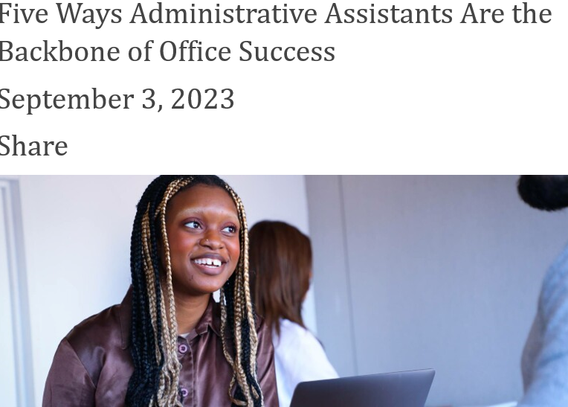
American Society of Administrative Professionals Says…..
What resonates with you?
What is challenging?
What is rewarding?

Slide 8
The ability to influence someone successfully is one of the most important and challenging jobs any leader will face.
5 Characteristics Every Good Leader Should Have
Decisiveness. The ability to make decisions, particularly when under pressure, is an important skill to master. ...
Trustworthiness. ...
Empowerment of others. ...
Clear communication. ...
Resilience.

Slide 9
Working Definition of Influence
Influence is the ability to change how someone else behaves or thinks based on persuasion instead of authority.
Unlike power, influence doesn’t allow you to directly impact someone’s actions or behavior just by telling them to do something.
Instead, you can influence others into changing the way they behave, think, or act using your personal skills. These skills include skills of persuasion and inspiration.
Relationships will also have an impact on influence. When you have a positive relationship based on trust with your peers, your actions and behaviors will be more likely to influence them.

Slide 10
Burnout & Resilience
Notes:
How to build teacher resiliency and avoid burnout! We're going to start with what research has to say and then share a few examples of practices to incorporate into our daily lives.

Slide 11
What the Research Says about Burnout
Burnout is a psychological syndrome emerging as a prolonged response to chronic interpersonal stressors on the job and causes exhaustion, cynicism, detachment, ineffectiveness, and lack of motivation (Maslach & Leiter, 2016, p. 103)
Burnout is associated with cognitive impairment in attention and memory (Deligkaris, Panagopoulou, Montgomery, & Masoura, 2014).
Fostering a collective sense of identity ("we" and "us") through leadership positively impacts team members' well-being, suggesting that emphasizing group cohesion over individualism is beneficial for overall wellness (Van Dick et al., 2021).

Slide 12
Practice Self-Compassion, Mindfulness, and Reflection
How do I Avoid Burnout?!

Slide 13
What Research Says About
Self-care, Reflection, & Mindfulness
Reflecting on our emotions allows us to consciously move all the way through them instead of staying stuck (Nagoski & Nogoski, 2019).
To have compassion for others, we must have the capacity to treat ourselves with compassion first (Neff, 2011).
Gratitude is one of our most powerful emotions. Studies show that when we practice gratitude consistently, we experience physical benefits, such as a stronger immune system and lowered symptoms of stress (Sansone & Sansone, 2010).
Practicing mindfulness improves emotional regulation, reduces stress, and enhances attention (Tang et al., 2015)

Slide 14
Practicing Mindfulness
There are clear indications that the practice of Mindfulness meditation helps in reducing levels of stress, anxiety, and depression (Morais et al., 2021).
Research shows that individuals can develop proficiency in mindfulness practices in 4-weeks (Isbel, Sysak, & Summers, 2020).
One recent study showed that mindfulness meditation was significantly effective in decreasing serum cortisol levels and perceived stress (Alhawatmeh et al., 2022).
Neuroscientist Amishi Jha discovered that 12 minutes of meditation, 5 days a week, can protect and strengthen your ability to pay attention (Jha, 2021).
Notes:
This is one example of a quick mindfulness practice that you can do anywhere. read through it and then I'm going to walk you through it one time.

Slide 15
Practice Mindfulness
Reflective Counting Strategy*
1. Sit comfortably, eyes open or closed
2. Take note of your surroundings, become aware of your breathing
3. Focus on the physical rising and falling of each breathe
4. Notice the tempo of your breathing, the shallowness and depth of each inhale and exhale.
5. When you’re ready, count to 10 on the inhale.
6. Then count down to 0 on the exhale.
7. Repeat the cycle 10 times (or until you feel a sense of peace in your mind and body).
** No other thoughts should be in your mind- just breathing and counting. If other thoughts enter- start back at 1.
Notes:
This is one example of a quick mindfulness practice that you can do anywhere. read through it and then I'm going to walk you through it one time.

Slide 16
Homework
You just wrote a best seller titled, “How to be a successful Administrative Assistant Read us the first sentence.

Slide 17
To Leave
Survey Link
Tthree things that resonated with you today
Write two things that you will commit to do (regularly) between now and our next session.
Write one question you have.

