Slide 1
Prop 2 ½ Overrides
An Overview
MASC Learning Lunch
Friday, February 2, 2024

Slide 2

What We Will Cover:
Background on Proposition 2 ½
Strategies From Successful Districts

Slide 3
What is Prop 2 ½?
Proposition 2 ½ is the name most commonly used to describe the law that determine the amount communities are limited to when raising taxes in the state of Massachusetts.
Passed in 1980, proponents intended it to be a guardrail against taxes rising too quickly and by unchecked amounts.
It uses each municipalities’ finances to calculate the levy ceiling, levy limit, and levy.

Slide 4

What Is A Levy?
A community’s LEVY CEILING is determined by calculating 2.5 percent of the total full and fair cash value of taxable real and personal property in the community.
The LEVY LIMIT is the maximum the levy can be in a given year.
The limit is based on the previous year’s limit plus certain
allowable increases.
The LEVY is the amount the community can raise through the
property tax. The levy can be any amount up to the levy limit.

Slide 5
What Is An Override?
An OVERRIDE allows a community to raise taxes by more than 2 ½ percent.
Communities will propose an override for a variety of reasons - to increase first responder staff, to fund a major project, or to increase the budget allotment of the schools.

Slide 6
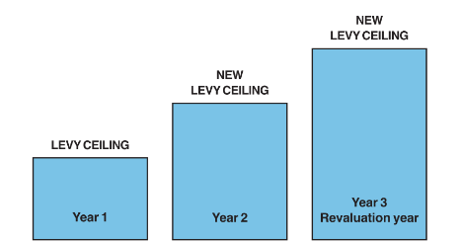
How the Levy Ceiling Rises:
Source: MA DOR

Slide 7
How does an Override Get Passed?
“Two separate steps are required: (1) town meeting or city council must appropriate funds and (2) voters of the city or town must approve a ballot question.
Either step may be taken first. Typically policy or timing issues dictate which order is preferable.
In towns only, if the required election will occur after the town meeting, the appropriation may (but need not) be made contingent upon passage of a Proposition 2 ½ ballot question. “
Source: K-PLaw.com

Slide 8
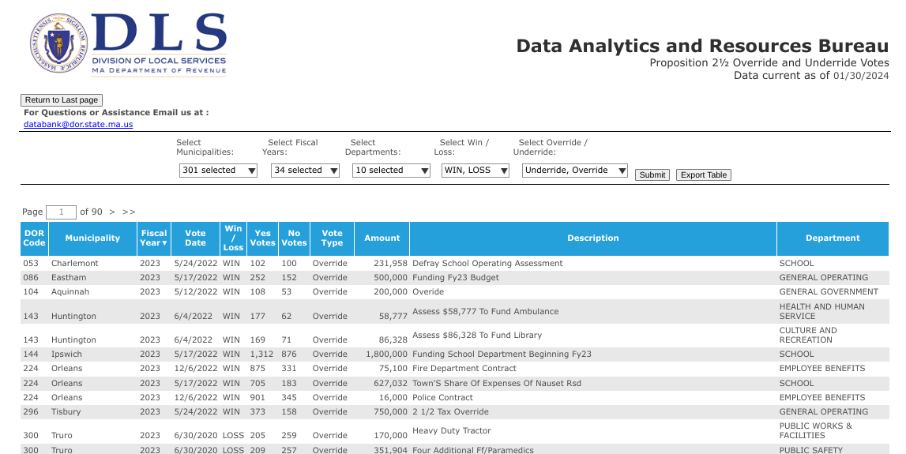

Slide 9
So my town has decided
to try to pass an override.
Now what?

Slide 10
DO NOT:
Use district resources for the override effort.
Including,
but not limited to:
Email
Copiers/Paper
Physical Spaces
Distribution Lists

Slide 11
What Can We Do?
“Specifically, elected officials and appointed policy-makers may take official actions concerning ballot questions relating to their particular areas
of official responsibility.”
MA.gov Ethics Commission Advisory 11-1
Public Employee Political Activity
Take an official position as you would on a warrant at town meeting.
Write letters as a committee member in support.
When in doubt - consult your legal counsel!

Slide 12
Step #1 - Organize
Form a Ballot Committee
  Volunteers who will work together to advocate and educate on behalf of the override.
  Register it with the town/state.
Choose a Steering Committee
  Smaller group of volunteers who will take the lead on organizing and delegating.
Designate a Treasurer
  The person responsible for all of the financial paperwork associated with lawn signs, printing, mailing, etc. and will open a bank account.

Slide 13
Step #2 - Tell Your Story
Why is this override necessary?
Who will benefit?
What is the alternative if it is not passed?
What resources are available for residents who might struggle with an increase in taxes?
Create FAQs, and Myths/Myths Busted

Slide 14


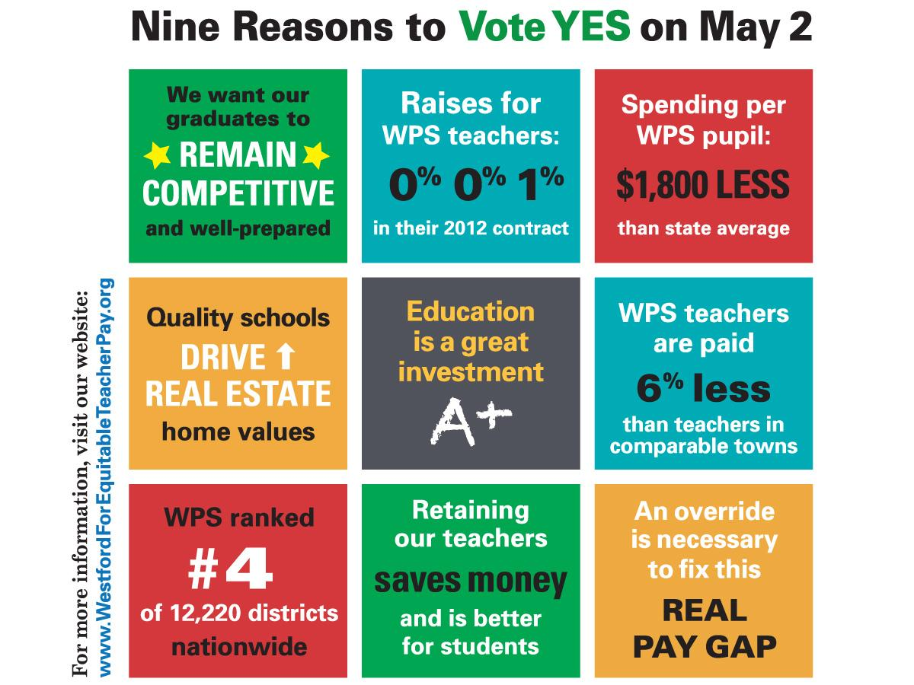
Notes:
Key Legislation and Regulations [next]
What policies you need to have. [next]
What are the Roles and Responsibilities for School Committees [next]
Dealing with parents.
Jim is going to lead you on a very brief poll to see what, if any, special education experience you have.
[CHANGE SLIDE]

Slide 15
Step #3 - Educate and Advocate
Outreach:
Website
Emails to friends
Letters to the editor
Videos on local; CAT
Postcards/mailers/reminders
Lawn signs & car signs
Visibility events

Slide 16
Step #3 - Educate and Advocate
Recruiting:
I commit to vote
Lawn signs hosting
Emails to friends
Postcard/ mailing help
Sign holding at town meetings/polls
Text reminders
Speakers at town meeting

Slide 17
Step #3 - Educate and Advocate
Other things to consider:
Road show tour of community spaces
  Senior Center
  Library
  Coffee shops
Childcare at town meeting

Slide 18
How Do We Do All That?
Create subcommittees to work on:
  Online and print graphics
  Email & online outreach
  Postcards & mailers
  Lawn sign distribution
  Childcare at town meeting
  Sign holders and speakers at town meeting

Slide 19
MA.gov
Proposition 2 ½
Overrides and Exclusions
K-PLaw.com/resources
Prop 2 ½ Override - A Practical Guide
DOR Reports:
dlsgateway.dor.state.ma.us/reports
Resources:

Slide 20


Slide 21
Massachusetts Association of School Committees
MASC.org
One McKinley Square
Boston, MA 02109
617-523-8454
Alicia (Curtin) Mallon
MASC Field Director/Search Coordinator
AMallon@MASC.org
(978) 729-1117

