Slide 1
Basics of Policy
MASC/MASS Joint Conference
November 8, 2023
Hyannis, Massachusetts

Slide 2
Role of the School Committee related to Policy
The School Committee is the Municipal Legislature for the schools in your district, therefore, the Committee governs through policy.
The Superintendent is the CEO of your school district, therefore, the Superintendent manages through policy implementation.
What
Why
How Much
How
Who
When
Where
Notes:
PH

Slide 3
Division of Effort
Goals, Vision, Vision for Student Outcomes
Accountability-
Advocacy
POLICIES
COMMITTEE’S WORK
ADMINISTRATION’S
WORK
Operations
Procedures
Personnel

Slide 4
Who Does What?
School Committee
Superintendent
Vision & Goals
Policies
Budget
Approves contracts
Monitors progress
Advocacy
Decides What & Why
Superintendent
Staff
Action plans
Regulations
Expenditures
Employee relations
Reports progress
Advocacy
Decides How & When
Governing Principles
Practical Application

Slide 5
Roles Defined
Statutes/Regulations
School Committee Policy
Superintendent Contract
Job Description
Institutional History
Operating Protocols
Notes:
Legal Requirements
Suggested reading
Shall:
332.005 Oath
332.040 Electing a chair
332.045 Provide for meetings
332.057 Perform at meetings
332.072 Educating children
332.075 Approve contracts
332.105 Other duties
332.405 Provide transportation
332.505 Policies
May:
332.075 Calendar & curriculum
332.505 Employ a supt
332.505 Employ personnel
332.505 Pay people
Policies BBA and BBAA – Committee; CBA - supt

Slide 6
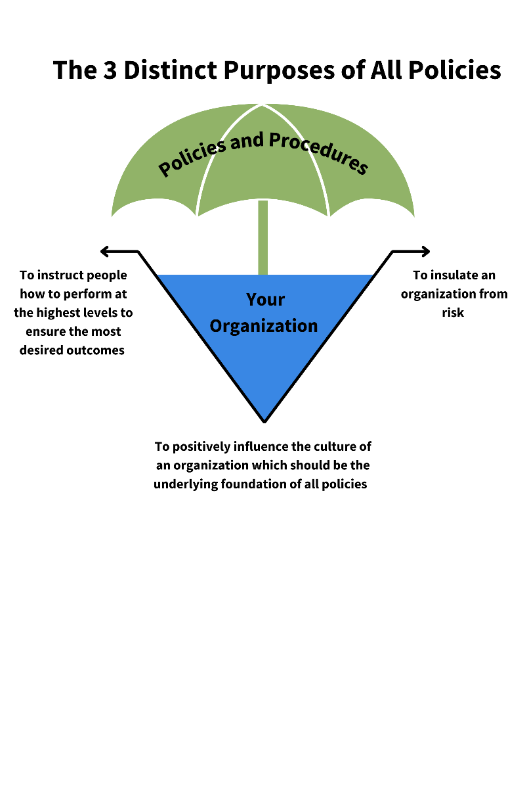
School Committee Policy is…
Policies are statements that set forth the purpose(s) and prescribe in general terms the organization and program of a school system.
Policies create a framework within which the Superintendent and their staff can discharge their assigned duties with positive direction.
Policy defines what is needed.
Notes:
PH

Slide 7
Not everything that is required, is required to be in policy!
Notes:
PH

Slide 8
POLICY
Administrative regulations
Internal procedures
Handbooks
Notes:
PH
Policy is the overarching direction…
Click of mouse - This page has animation to pull up remaining content

Slide 9
School Committee Policy is…
Policy is… a guideline adopted by the Committee to chart a course of action that is
Broad enough to allow administrative discretion
Specific enough to give clear guidance
Policy is the what and the why
Notes:
PH

Slide 10
NEPN (National Education Policy Network)
NEPN CODES Policy in these Categories
A – Foundations and Basic Commitments
B - School Committee Governance & Operations
C – School District Administration
D – Fiscal Management
E – Support Services
F – Facilities Planning & Development
G – Personnel
H – Negotiations
I – Instruction
J – Students
K – School, Community, & Home Relations
L- Education Agency Relations

Slide 11
What Policy is Not
Detailed direction
Procedures
Process
Forms, job descriptions, fee lists, etc.
Notes:
PH

Slide 12
Procedure (or Regulation) is …
Detailed directions
Developed by administration
Reviewed by the Committee (if required)
Puts policy into practice
Tells how, by whom, where and when things are to be done
Notes:
PH

Slide 13
When Reviewing Current Policy ask:
Is it legal ?
Does it reflect current practice?
Is it working? If not, what needs to be changed?
Do we need it? Don’t be afraid of repealing policies that are no longer relevant. (Sometimes “less is more” )
Notes:
PH
All OSBA samples went through review by OSBA legal staff. OSBA legal staff and policy specialists are available to answer questions about our samples. Related questions/concerns are recommended for referral to the school district’s attorney.

Slide 14
When Reviewing Policy Check These:
Policy Manual
Collective Bargaining Agreements/Contracts
Parent/Student Handbooks
Staff/Employee Handbooks
Budget document
Notes:
PH
Never put collective bargaining language in policy! Make sure your handbooks line up with any policy revisions!

Slide 15
MASC Policy Services Overview
Policy Manual Review – to review update existing policy manual, with an option for an online, searchable application, with links to legal references - paper copy available (for a fee)
Policy Update Newsletter
Online Manual Maintenance
Individual Policy Guidance
• Contract Policy Review Service (Fee)
• Policy 21 Online Policy Service (Fee)
• Online Policy Review Service (Fee)
Notes:
Click of mouse - This page has animation to pull up remaining content

Slide 16
We Can Help
Liz Lafond
Field Director – Policy Services
llafond@masc.org
Alicia Mallon
Field Director
amallon@masc.org

Slide 17
QUESTIONS?

