Slide 1
Liaising With Your PACs
Tapping in to a Resource for Equity

Slide 2
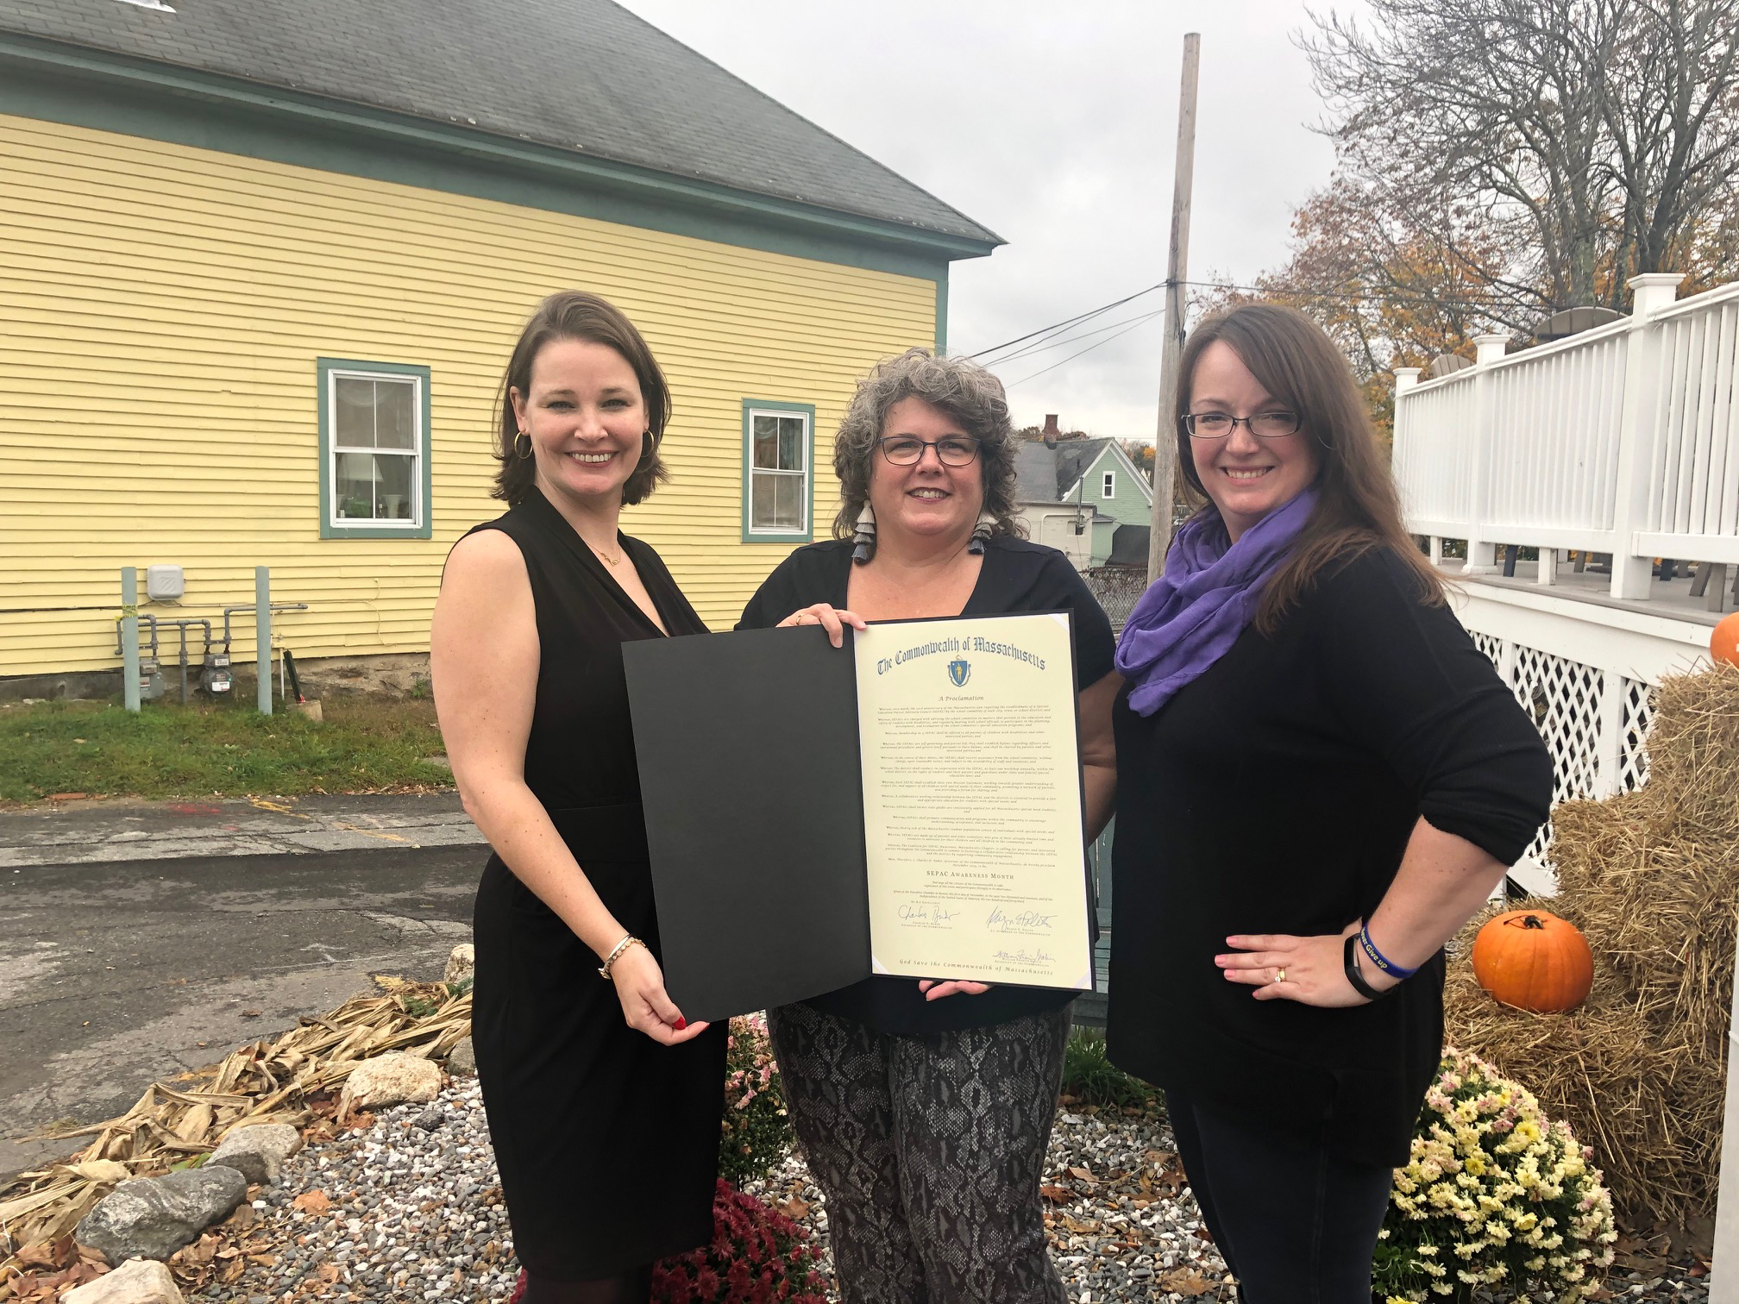
Who We Are
Alicia Curtin Mallon - Westford, MA Past SEPAC board member, past Westford School Committee member Current School Committee Member - Nashoba Valley Technical High School Author of a bill that proposes expanding SEPAC and ELPAC inclusion State House testimony for Special Education Support Co-Author of the Proclamation for SEPAC Awareness Co-founder of the Coalition for SEPAC Awareness, MA Chapter MASC Field Director Laurie McCarron - Chelmsford, MA PAC-to-PAC co-founder and admin Past SEPAC board member and current parent member MA Special Education Panel MFOFC alumni Special Education Parent Trainings State House testimony for Special Education Support Co-Author of the Proclamation for SEPAC Awareness Co-founder of the Coalition for SEPAC Awareness, MA Chapter Kathy Healy Norton - Westford, MA PAC-to-PAC co-founder and admin Past Westford SEPAC board member State House testimony for Special Education Support Co-Author of the Proclamation for SEPAC Awareness Co-founder of the Coalition for SEPAC Awareness, MA Chapter

Slide 3
What We Will Cover:
School Committee Responsibilities
What is a SEPAC?
What is an ELPAC?
The Role of SEPACs and ELPACs
Engaging your PACs
Resources
Questions/Comments

Slide 4
School Committee Responsibilities
Establish district policies
Establish equitable district budget
Confirm superintendent’s recommendation for special education director
Liase with SEPACs and ELPACs
To be able to…
Effectively advocate for students with Special Needs and English Learners

Slide 5
What is a SEPAC?
"…. The school committee of any city, town, or school district shall establish a parent advisory council on special education. Membership shall be offered to all parents of children with disabilities and other interested parties. The parent advisory council duties shall include but not be limited to: advising the school committee on matters that pertain to the education and safety of students with disabilities; meeting regularly with school officials to participate in the planning, development, and evaluation of the school committee's special education programs. The parent advisory council shall establish by-laws regarding officers and operational procedures. In the course of its duties under this section, the parent advisory council shall receive assistance from the school committee without charge, upon reasonable notice, and subject to the availability of staff and resources. …"
MGL Chapter 71B, Section 3

Slide 6
What is an ELPAC?
The "Act Relative to Language Opportunity for Our Kids," Chapter 138 of the Acts of 2017, commonly referred to as the “LOOK Act,” was signed into law by Governor Baker on November 22, 2017. Related to ELPACs, the LOOK Act requires the following schools or districts to establish ELPACs:
School districts or charter schools operating a language acquisition program for ELs serving 100 or more ELs or in which ELs comprise at least five percent of the school district’s or charter school’s student population, whichever is less.
Schools designated as underperforming or chronically underperforming and operating a program for ELs.

Slide 7
Ideas for effectively liaising with your PACs
Send a SC liaison to the PAC meetings.
Invite the PACs to a School Committee meeting to present on their activities.
Evaluate and create district policies that consider all students and families by soliciting input from PACs.
Support the sharing of district information regarding PACs with the entire community.
When putting together advisory committees, share out to the PACs to ensure stakeholder involvement.

Slide 8
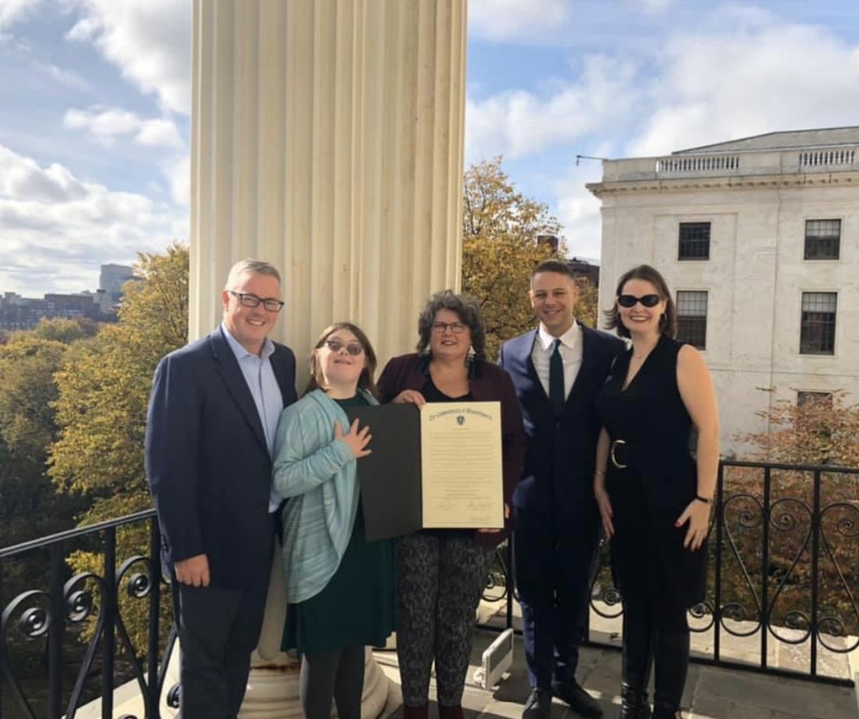
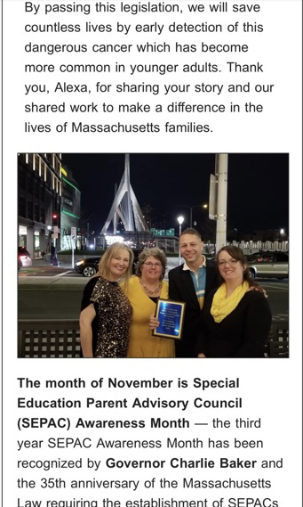
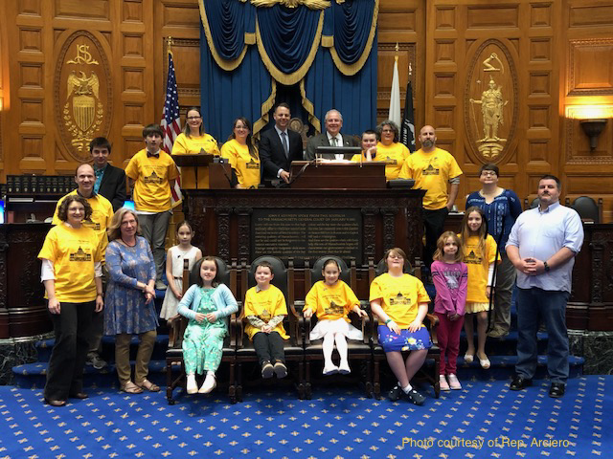
November is SEPAC Awareness Month.

Slide 9
Resources:
MA DESE Guidance for SEPACs and ELPACs https://www.doe.mass.edu/
The Federation for Children with Special Needs https://fcsn.org/ MASSPAC https://fcsn.org/masspac/ The Fedreration’s ELPAC Guidance https://fcsn.org/wp-content/uploads/sites/2/2022/05/English-Learners-and-ELPACs.pdf
The Coalition for SEPAC Awareness MA https://sepacawarenessma.com/

Slide 10
Local SEPACs and ELPACs
Weymouth Public Schools’ SEPAC https://www.weymouthschools.org/district/weymouth-special-education-parent-advisory-council-sepac
Westford Public Schools’ SEPAC https://sepacwestford.wixsite.com/my-site Worcester Public Schools’ ELPAC https://worcesterschools.org/student-support/multilingual-education/english-learner-parent-advisory-council-elpac/
Brookline Public Schools’ ELPAC https://www.brookline.k12.ma.us/Page/2512

Slide 11
Questions/Comments?

